Slide 1
Inheritance

Slide 2
Inheritance
In C++, inheritance is a process in which one object acquires all the properties and behaviors of its parent object automatically.
In such way, you can reuse, extend or modify the attributes and behaviors which are defined in other class.
In C++, the class which inherits the members of another class is called derived class and the class whose members are inherited is called base class.
The derived class is the specialized class for the base class.
Advantage
Code reusability: Now you can reuse the members of your parent class. So, there is no need to define the member again. So less code is required in the class.

Slide 3
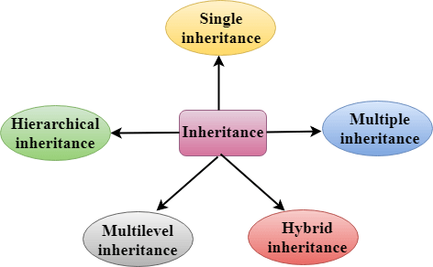
Types Of Inheritance

Slide 4
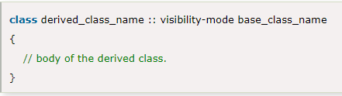
Derived Classes
A Derived class is defined as the class derived from the base class.
The Syntax of Derived class:
derived_class_name: It is the name of the derived class.
visibility mode: The visibility mode specifies whether the features of the base class are publicly inherited or privately inherited. It can be public or private.

Slide 5
base_class_name: It is the name of the base class.
When the base class is privately inherited by the derived class, public members of the base class becomes the private members of the derived class. Therefore, the public members of the base class are not accessible by the objects of the derived class only by the member functions of the derived class.
When the base class is publicly inherited by the derived class, public members of the base class also become the public members of the derived class. Therefore, the public members of the base class are accessible by the objects of the derived class as well as by the member functions of the base class.
Note:
In C++, the default mode of visibility is private.
The private members of the base class are never inherited.

Slide 6

C++ Single Inheritance
Single inheritance is defined as the inheritance in which a derived class is inherited from the only one base class.
Where 'A' is the base class, and 'B' is the derived class.

Slide 7
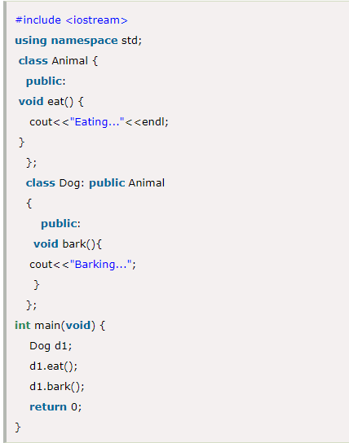
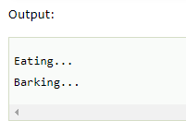
C++ Single Level Inheritance Example

Slide 8
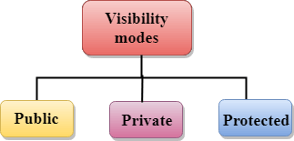
How to make a Private Member Inheritable
The private member is not inheritable. If we modify the visibility mode by making it public, but this takes away the advantage of data hiding.
C++ introduces a third visibility modifier, i.e., protected. The member which is declared as protected will be accessible to all the member functions within the class as well as the class immediately derived from it.

Slide 9
Public: When the member is declared as public, it is accessible to all the functions of the program.
Private: When the member is declared as private, it is accessible within the class only.
Protected: When the member is declared as protected, it is accessible within its own class as well as the class immediately derived from it.

Slide 10

C++ Multilevel Inheritance
Multilevel inheritance is a process of deriving a class from another derived class.

Slide 11
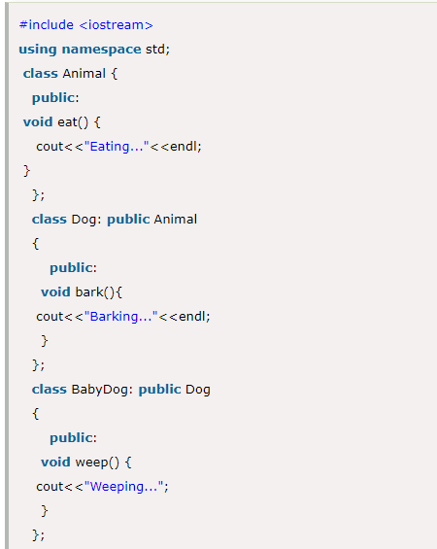
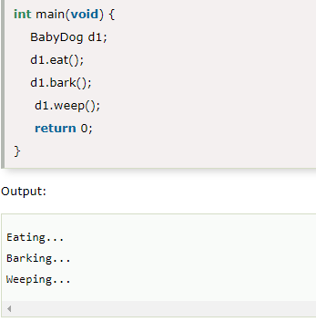
C++ Multi Level Inheritance Example

Slide 12
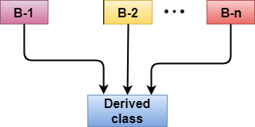
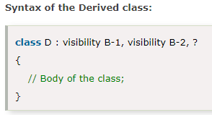
C++ Multiple Inheritance
Multiple inheritance is the process of deriving a new class that inherits the attributes from two or more classes.

Slide 13
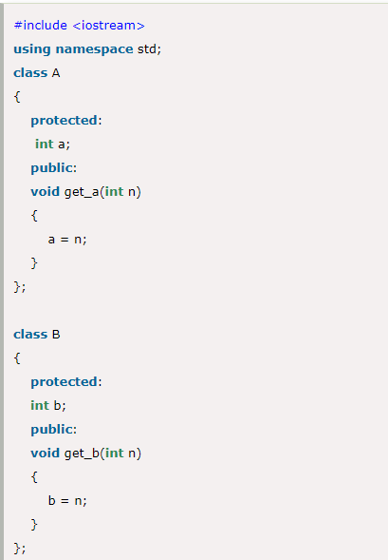
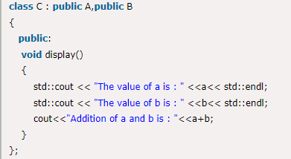
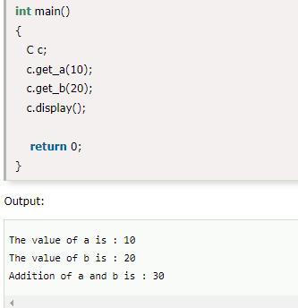
Example of Multiple Inheritance.

Slide 14
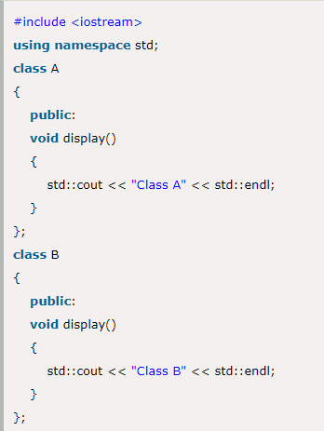
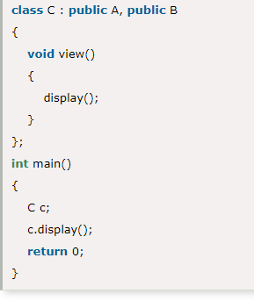
Ambiguity Resolution in Inheritance
Ambiguity can be occurred in using the multiple inheritance when a function with the same name occurs in more than one base class.
Let's understand this through an example:

Slide 15
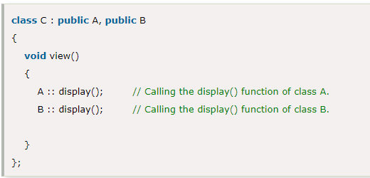
The above issue can be resolved by using the class resolution operator with the function. In the above example, the derived class code can be rewritten as:

Slide 16
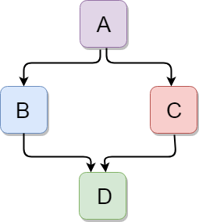
C++ Hybrid Inheritance
Hybrid inheritance is a combination of more than one type of inheritance.

Slide 17
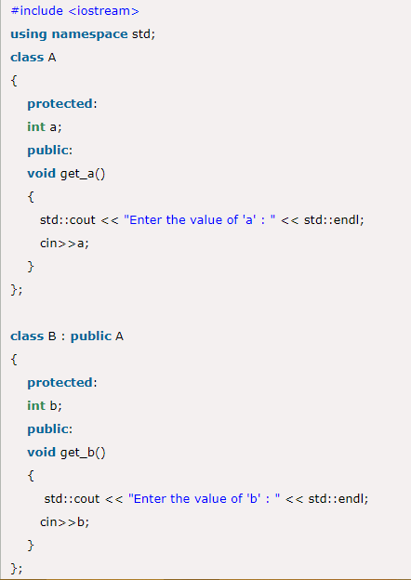
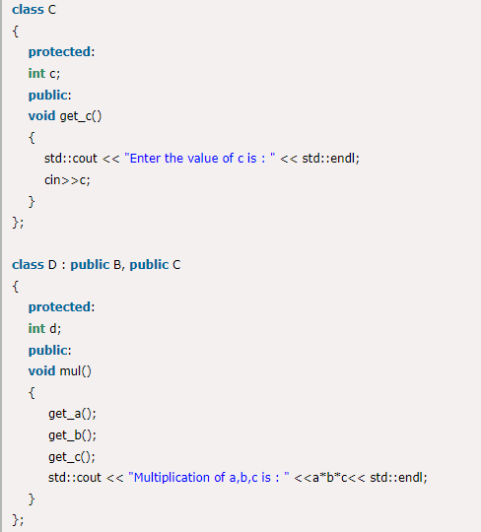
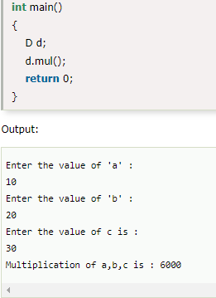
Example

Slide 18
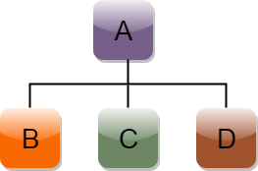
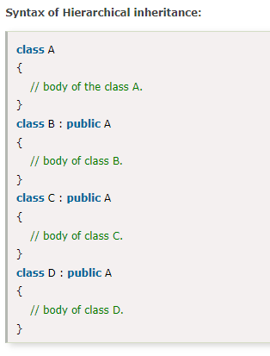
C++ Hierarchical Inheritance
Hierarchical inheritance is defined as the process of deriving more than one class from a base class.

Slide 19
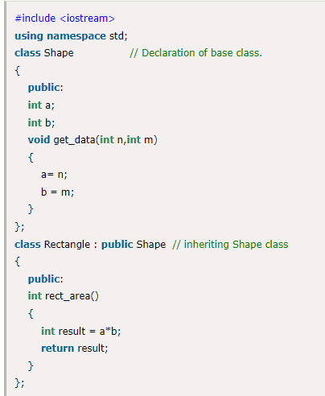
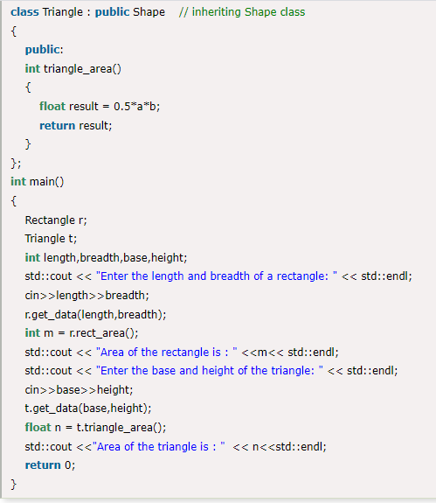
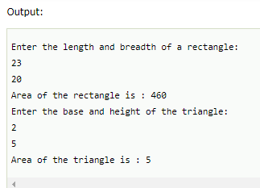
Example

Slide 20
C++ Operators Overloading
Operator overloading is a compile-time polymorphism in which the operator is overloaded to provide the special meaning to the user-defined data type.
Operator overloading is used to overload or redefines most of the operators available in C++.
It is used to perform the operation on the user-defined data type.
For example, C++ provides the ability to add the variables of the user-defined data type that is applied to the built-in data types.
The advantage of Operators overloading is to perform different operations on the same operand.

Slide 21
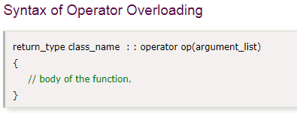
Operator that cannot be overloaded are as follows:
Scope operator (::)
Sizeof
member selector(.)
member pointer selector(*)
ternary operator(?:)
Where the return type is the type of value returned by the function.
class_name is the name of the class.
operator op is an operator function where op is the operator being overloaded, and the operator is the keyword.

Slide 22
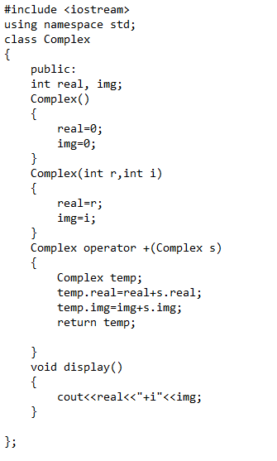
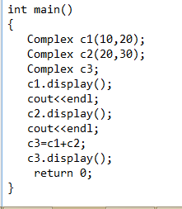
C++ Operators Overloading Example

